Slide 1

Pre-Bid Conference
Invitation for Bids: DCAM-26-CS-IFB-0001
Redevelopment of St. Elizabeths East Campus-
Sycamore Drive SE Infrastructure Improvements
December 18, 2025

Slide 2
Pre-Bid Conference:
Redevelopment of St. Elizabeths East Campus Sycamore Drive SE Infrastructure Improvements
Agenda
DMPED/DGS Team Introductions
St Elizabeths East Program Background and Objectives
St. E Program Construction Overview
Infrastructure Improvements
Invitation for Bid Overview
Project Milestones
Q & A Session

Slide 3
Team Introduction
Latrena Owens
Director Real Estate
DMPED
District Department of Transportation
(DDOT)
Washington Metro Area Transit Authority
(WMATA)
Osei Headley
Deputy Director of
Capital Construction - DGS
District Department of Energy & Environment
(DOEE)
District of Columbia Water Authority
(DC Water)
Renee Holmes
Executive Program Manager / COTR- DGS
Partner Agencies
Xavier Beltran
Interim Chief Procurement Officer - DGS
Kevon Levenberry
Project Manager - DGS
Richard Staudinger
Engineer-of-Record
Jacobs Engineering
James Marshall
Contract Specialist
DGS

Slide 4
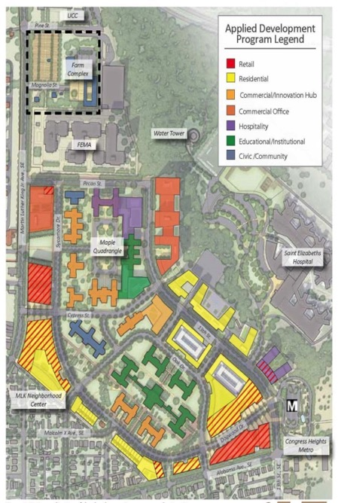
Pre-Bid Conference:
Redevelopment of St. Elizabeths East Campus Sycamore Drive SE Infrastructure Improvements
St. Elizabeths East Campus Program Background and Objectives
East Campus Existing Conditions:
Primarily a vibrant redeveloped campus now
Underlying Zoning: St E District
Buildable Envelope: +5 million square feet (multiple parcels)
Office: 1.8 million SF, including 500,000 SF of
“Innovation Hub” space
Residential: 1,300 units
Retail: 206,000 SF
Hospitality: 330,000 SF
Civic & Educational: 250,000 SF for non-commercial
activity centers

Slide 5
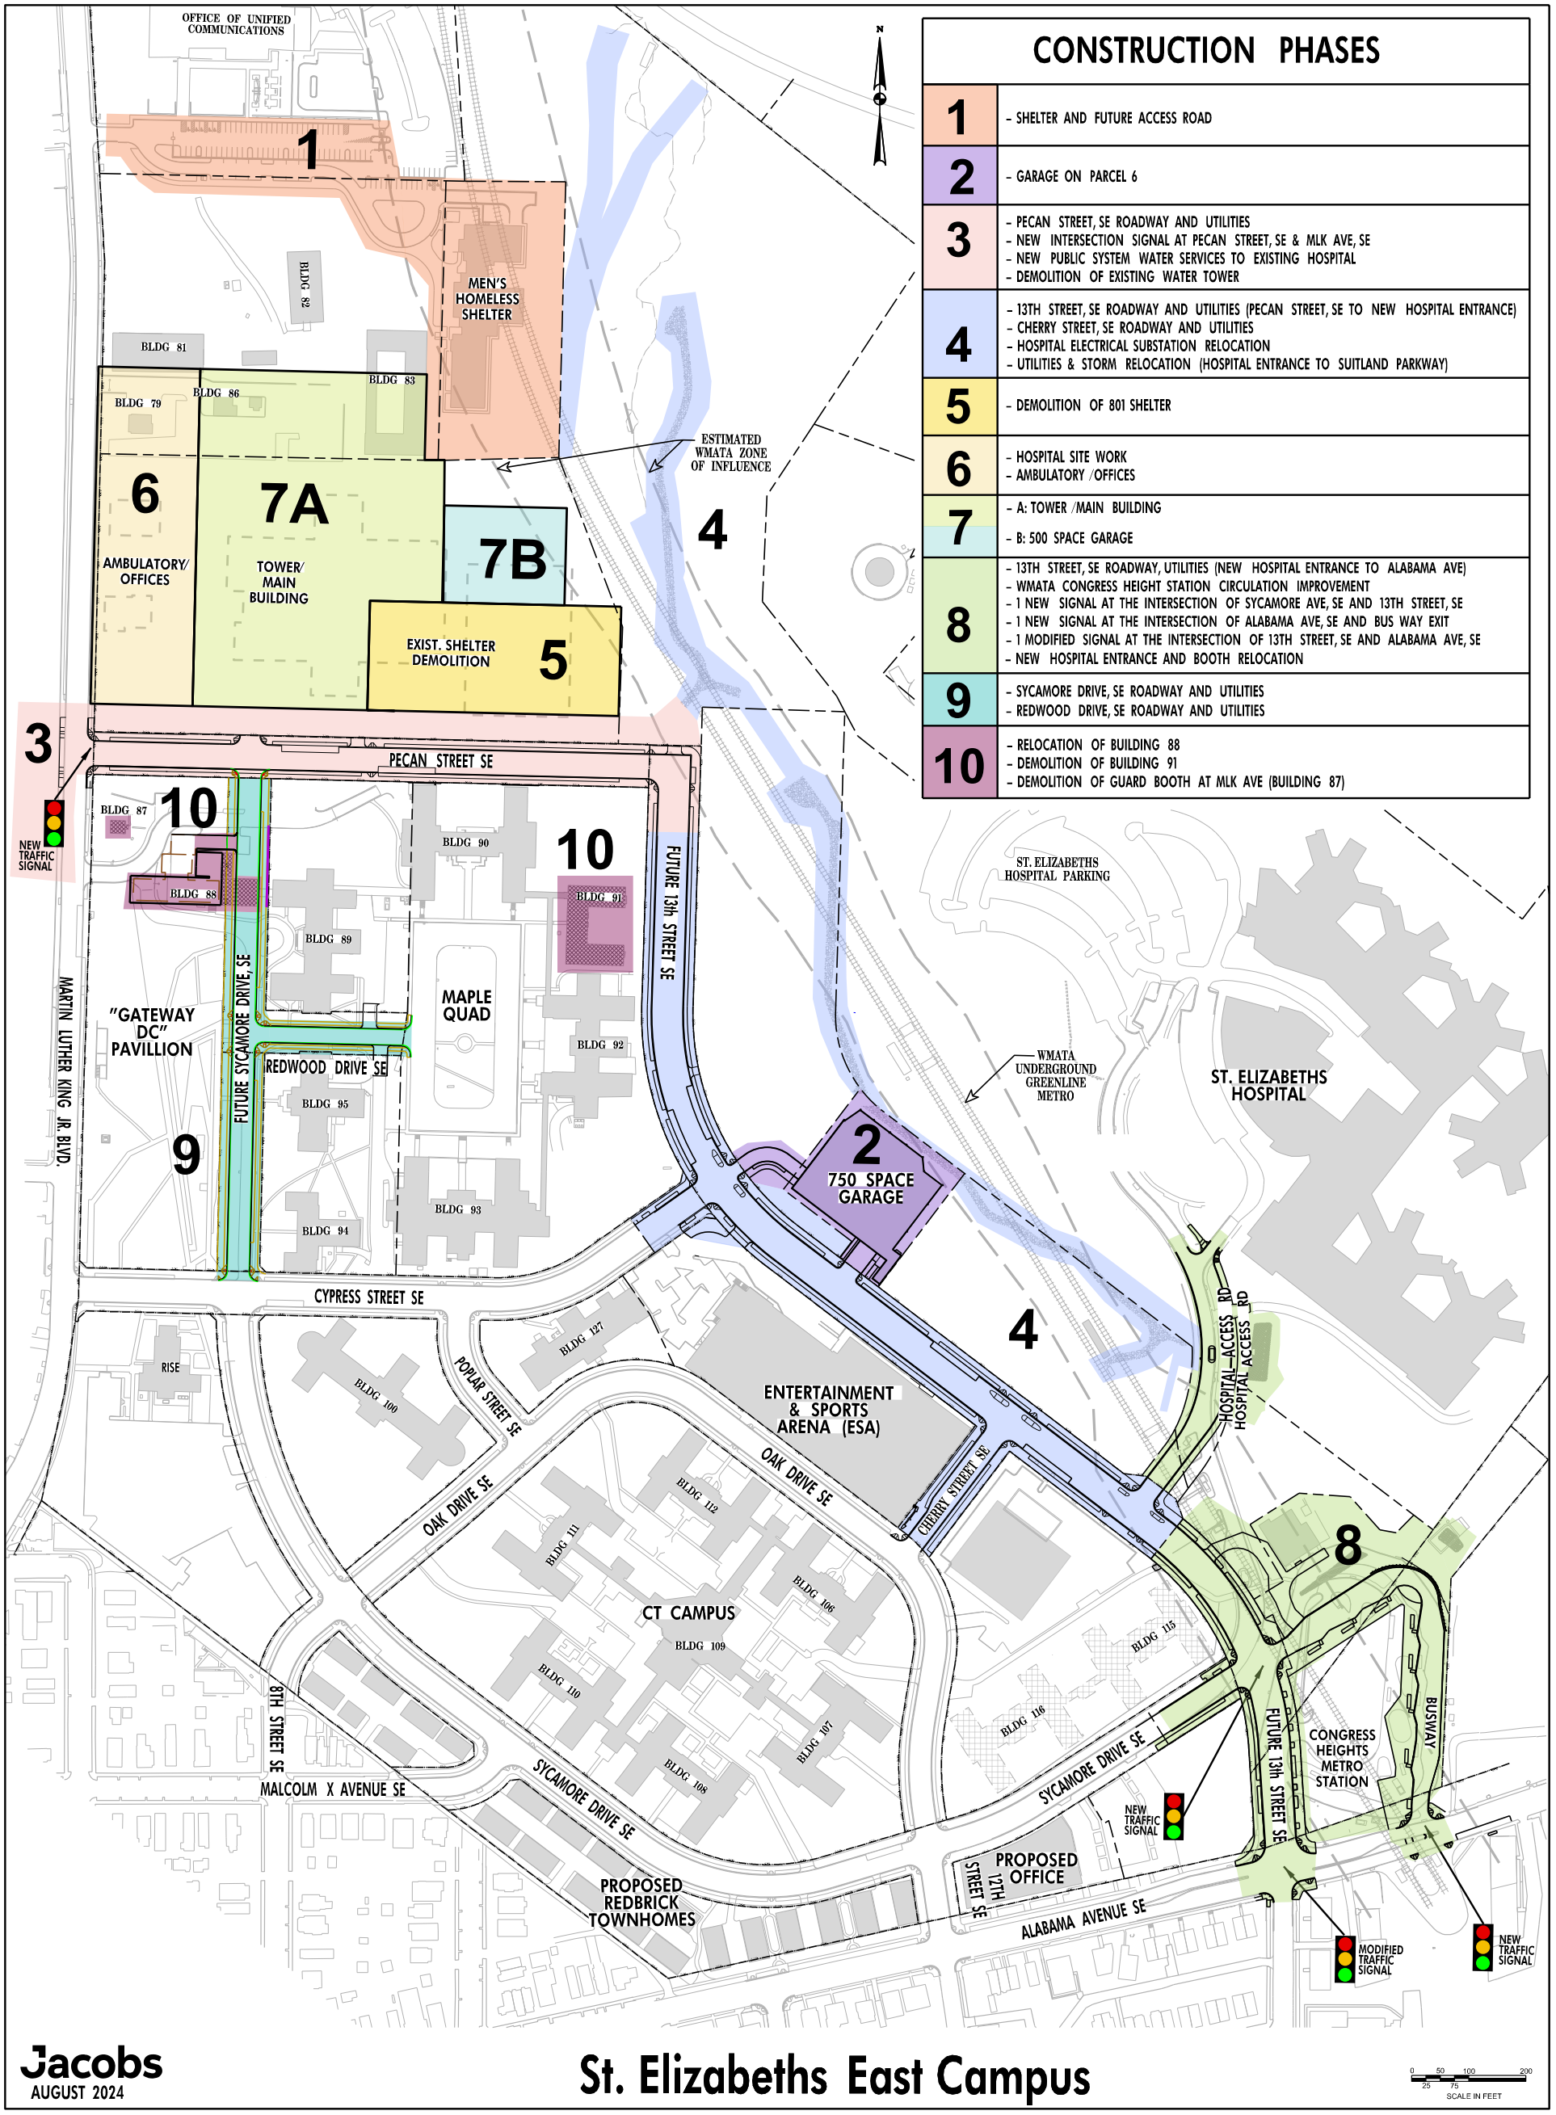
Pre-Bid Conference:
Redevelopment of St. Elizabeths East Campus Sycamore Drive SE Infrastructure Improvements
St. Elizabeths East Campus
Construction Phasing Overview
(Phases 1 thru 10)

Slide 6
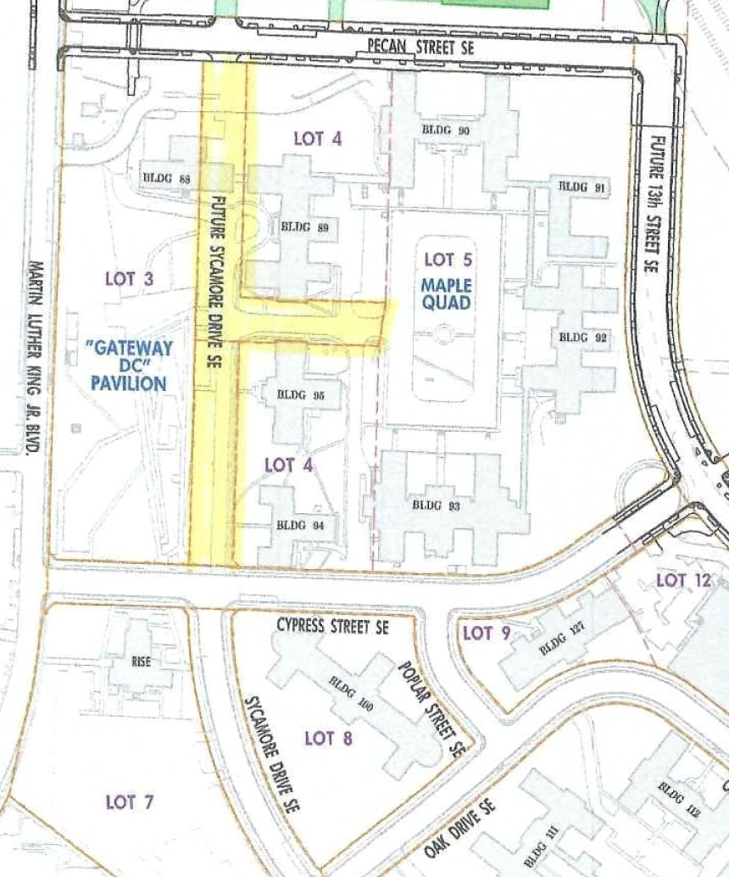
Pre-Bid Conference:
Redevelopment of St. Elizabeths East Campus Sycamore Drive SE Infrastructure Improvements
St. Elizabeths East Campus Program:
Infrastructure Improvements
PROJECT LIMITS

Slide 7
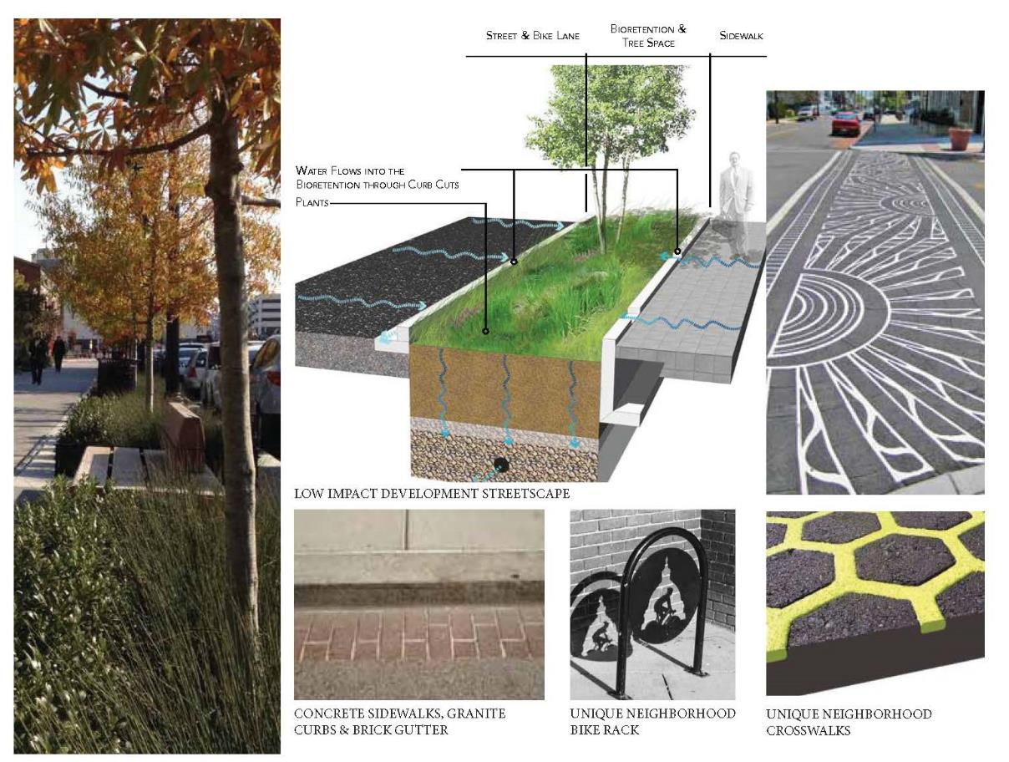
Pre-Bid Conference:
Redevelopment of St. Elizabeths East Campus Sycamore Drive SE Infrastructure Improvements
St. Elizabeths East Campus Program: Infrastructure Improvements
Some Landscape Features:

Slide 8
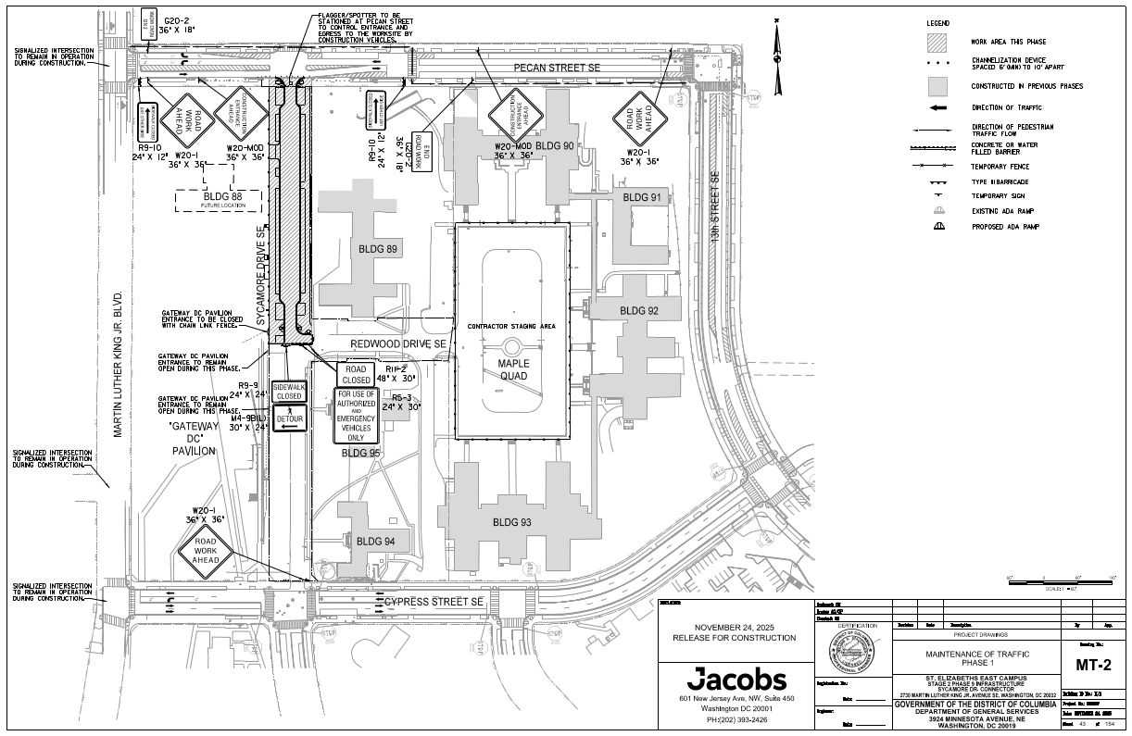
Pre-Bid Conference:
Redevelopment of St. Elizabeths East Campus Sycamore Drive SE Infrastructure Improvements
St. Elizabeths East Campus Program: Infrastructure Improvements
Maintenance of Traffic (MOT) for Sequence of Construction (Phases 2 thru 7)
ALL NEW SLIDES FOR 13TH STREET MOT TO BE ADDED

Slide 9
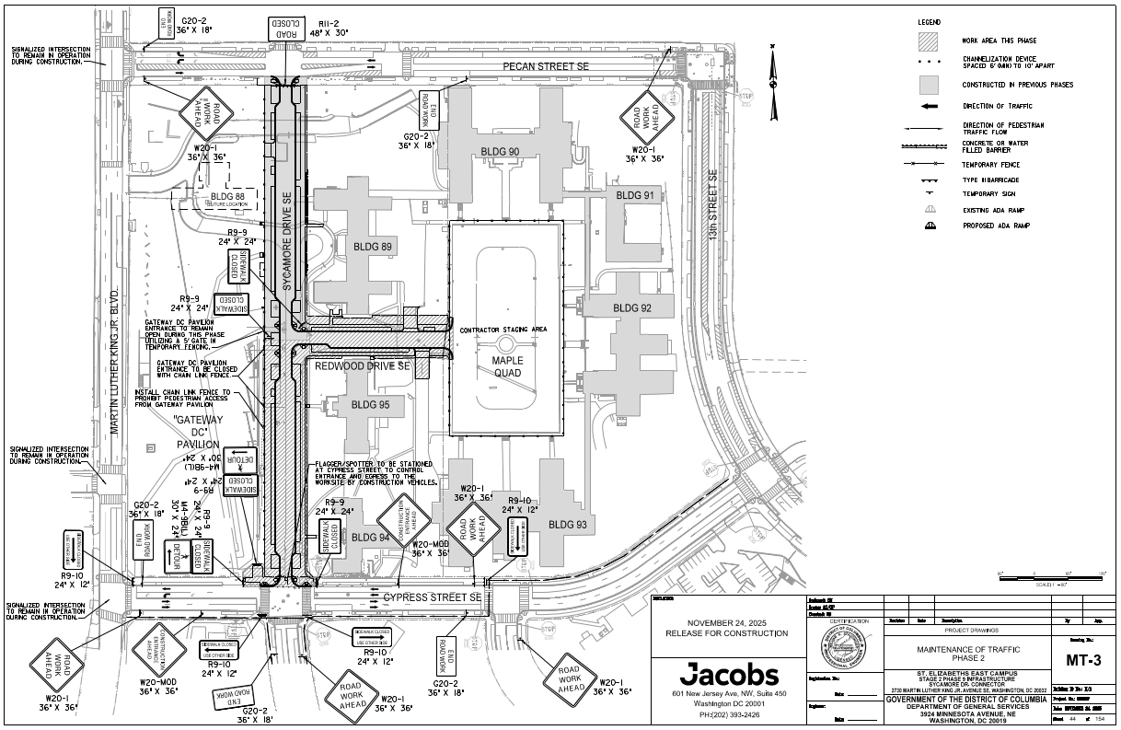
Pre-Bid Conference:
Redevelopment of St. Elizabeths East Campus Sycamore Drive SE Infrastructure Improvements
St. Elizabeths East Campus Program: Infrastructure Improvements
Maintenance of Traffic (MOT-3)

Slide 10
Pre-Bid Conference:
Redevelopment of St. Elizabeths East Campus Sycamore Drive SE Infrastructure Improvements
Sycamore Drive SE Infrastructure Improvements
Drawings and Specific Project Specifications
J.1.1 Sycamore Drive SE Infrastructure Improvements (Contract Plans)
J.1.2 DDOT Standard Specifications for Highways and Structures, 2013,
revised 2020 (DDOT Gold Book)
J.1.3 Project Special Provisions
J.1.4 Limited Cleanup Plan for CCR Contaminated Soil during Stage 2
Utility Installation Activities
J.1.5 St. Elizabeth East Campus – Stage 1 Phase 1 – Geotechnical and
Pavement Design Report – February, 2017
J.1.6 A&T lots 827 & 862– Future ROW limits

Slide 11
Pre-Bid Conference:
Redevelopment of St. Elizabeths East Campus Sycamore Drive SE Infrastructure Improvements
Sycamore Drive SE Infrastructure Improvements
Drawings and Specific Project Specifications
J.1.7 RESERVED
J.1.8 Project Sign
J.1.9 Parcel Map of East Campus dated April 2024
J.1.10 Existing Utilities Map of East Campus
J.1.11 St Elizabeths East Campus Stage 1 & 2 Areas - Overall Testing Reports
for Suspected Contaminated Soil Areas and Composite Mapping of
Locations
J.1.12 Tree Removal Permit
J.1.13 Proposed Utilities 3D PDF

Slide 12
Pre-Bid Conference:
Redevelopment of St. Elizabeths East Campus Sycamore Drive SE Infrastructure Improvements
Invitation for Bid Overview
Set-Aside - In accordance with D.C. Official Code § 2-218.0, this procurement has been set-aside for Small Business Enterprises
Contract Type - fixed unit price with a ceiling equal to the total Contract amount for the infrastructure and roadway improvements project.
Section B.3 Price Schedule – Offer Letter and Bid Form (Attachment J.2)
Section C – Scope of Work and Attachments J.1.1 – J.1.13
Section F.1 Term of Contract – 370 Calendar Days
  Substantial Completion 30 days before Final Acceptance
  Final Acceptance 370 calendar Days from Notice to Proceed
Section F2 - Deliverables
2

Slide 13
Pre-Bid Conference:
Redevelopment of St. Elizabeths East Campus Sycamore Drive SE Infrastructure Improvements ments
Invitation for Bid Overview
Compliance and Special Requirements
  Section H.1 and H.5 First Source Employment Agreement D.C. Official Code § 2-219.01 et seq. (First Source Act)
  Section H.2 Davis Bacon Act, 41 U.S.C. § 351 et seq., and 29 CFR 5.5 Davis Bacon Provision (Attachment J.4)
  Section H.6 Living Wage Act - D.C. Code §§ 2-220.01 – 2-220.11 (Attachement J.8)
  Section H.7 Subcontracting Requirements– D.C. Code § 2–218.46 (Attachment J.5)
2

Slide 14
Pre-Bid Conference:
Redevelopment of St. Elizabeths East Campus Sycamore Drive SE Infrastructure Improvements
Invitation for Bid Overview
Contract Clauses
  Section I.1 Standard Contract Provisions (Attachment J.3)
  Section I.9 Insurance Requirements
  Section I.10 Equal Employment Opportunity District of Columbia Administrative Issuance System, Mayor’s Order 85-85 dated June 10, 1985 (Attachment J.7)
  Section I.15 Bonds
    Bid Bond
    Payment and Performance Bonds
    Maintenance Bond
2

Slide 15
Pre-Bid Conference:
Redevelopment of St. Elizabeths East Campus Sycamore Drive SE Infrastructure Improvements
Invitation for Bid Overview
Section L Instructions to Bidders
  Section L.1 Method of Award The District intends to make one contract award resulting from this Solicitation to the responsive and responsible Bidder who has the lowest evaluated bid.
  Section L.2 Due Date Bids must be submitted electronically to https://procurement.opengov.com/portal/dc no later than 2:00PM January 21, 2026.
  Section L.7 Questions About the Solicitation 4:00pm December 29, 2025
  Section L.16 Standards of Responsibility
    Section L.16.3 Special Standards of Responsibility
2

Slide 16
Pre-Bid Conference:
Redevelopment of St. Elizabeths East Campus Sycamore Drive SE Infrastructure Improvements
Invitation for Bid Overview
L.16.3 Special Standards of Responsibility
The Department has determined that it is important to the timely and successful completion of the Project that the Contractor and the Project Superintendent have specific expertise and experience similar in size and scope as those described in Section C.5 and the Contract Plans (Attachment J.1.1).

Slide 17
Pre-Bid Conference:
Redevelopment of St. Elizabeths East Campus Sycamore Drive SE Infrastructure Improvements
Invitation for Bid Overview
L.16.3.1 The Department has determined that the Bidder have successfully completed a minimum of three (3) roadway projects within 15 miles of a metropolitan area with a population greater than 700,000 within the past seven (7) years with a contract value for each of $5,000,000 or greater. In response to this Special Standard of Responsibility, the Bidder shall provide the following for each of the projects:
  Name;
  Location/Address;
  Owner;
  Start Date and End Date;
  Dollar Amount; and
  Point of Contact name, phone number and email address.

Slide 18
Pre-Bid Conference:
Redevelopment of St. Elizabeths East Campus Sycamore Drive SE Infrastructure Improvements
Invitation for Bid Overview
L.16.3.2 The Department has determined that at a minimum, the Field Superintendent shall have a minimum of ten (10) years of roads and highway construction experience as the Field Superintendent for a minimum of two (2) roadway projects successfully completed within 15 miles of a of a metropolitan area with a population greater than 700,000 within the past ten (10) years with a contract value for each of $5,000,000 or greater. The Bidder shall identify the Field Superintendent and provide the following information relative to the Field Superintendent’s projects:
  Name;
  Location/Address;
  Owner;
  Start Date and End Date; and
  Dollar Amount.

Slide 19
Pre-Bid Conference:
Redevelopment of St. Elizabeths East Campus Sycamore Drive SE Infrastructure Improvements
Invitation for Bid Overview
Section L.17 Instruction to Bidders
L.17.1 Offer Letter and Bid Form (Attachment J.2)
L.17.2 Attachments
      Signed page 1 of the IFB;
      Acknowledgement of Amendments (Section A.13);
      The IFB pages 1 – 89 in its entirety;
      SBE Subcontracting Pan (Attachment J.5);
      First Source Employment Agreement and initial Employment Plan (Attachment J.6)
      EEO Policy Statement (Attachment J.7);
2

Slide 20
Pre-Bid Conference:
Redevelopment of St. Elizabeths East Campus Sycamore Drive SE Infrastructure Improvements
Invitation for Bid Overview
L.17.2 Attachments continued
    g. Bidder/Offeror Certification Form (Attachment J.9);
    h. Conflict of Interest Disclosure Statement (Attachment J.10);
    i. Certification to provide Payment and Performance Bonds
    (Attachment J.12);
    j. Bid Bond (Attachment J.13) or Bid Guarantee (Attachment J.14);
    k. Tax Affidavit - Attachment J.15.
    Campaign Finance Reform Self-Certification (Attachment J.16)
    Clean Hands Certificate available at https://mytax.dc.gov/_/ ; and
    Response to Special Standards of Responsibility as detailed in Section L.16.3 of this IFB.
Please thoroughly review all attachment and
ensure are filled out completely.
Failure to do so could lead your bid to be determined non-responsive
2

Slide 21
Pre-Bid Conference:
Redevelopment of St. Elizabeths East Campus Sycamore Drive SE Infrastructure Improvements
PROJECT MILESTONES
Pre-Bid Conference and December 18, 2025, 10:00AM
Site Visit
Last day for Questions: December 29, 2025, by 4:00PM
Bid Due Date: January 21, 2026, by 2:00PM
Bid Opening: January 21, 2026, at 3:00PM
Notice of Award February 2026
Notice to Proceed (NTP) February 2026
Final Acceptance 370 days from NTP
7

Slide 22
Pre-Bid Conference:
Redevelopment of St. Elizabeths East Campus Sycamore Drive SE Infrastructure Improvements
Q & A Session

Slide 23

St. Elizabeths East Campus Redevelopment Program
Connect with DGS!
Contact: dgs@dc.gov
Facebook: www.facebook.com/dcdgs
Twitter: www.twitter.com/dcdgs
Instagram: www.instagram.com/dcdgs

